Slide 1
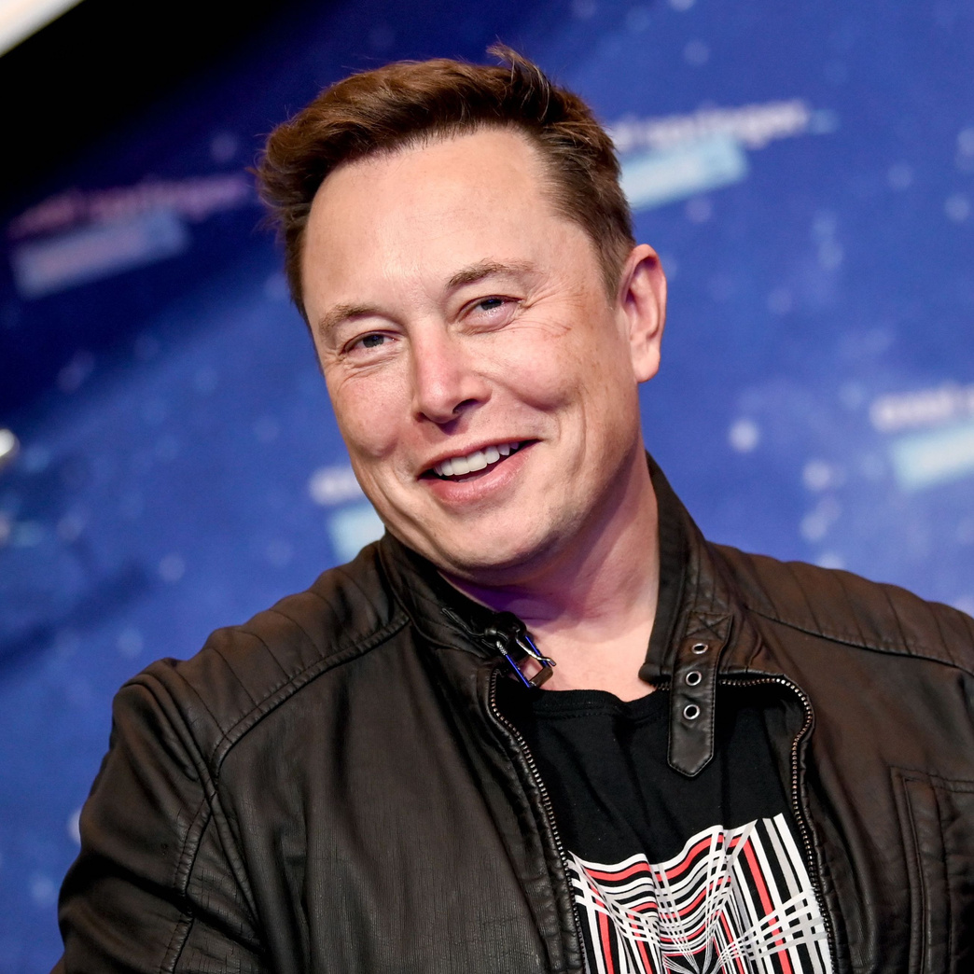

Slide 2
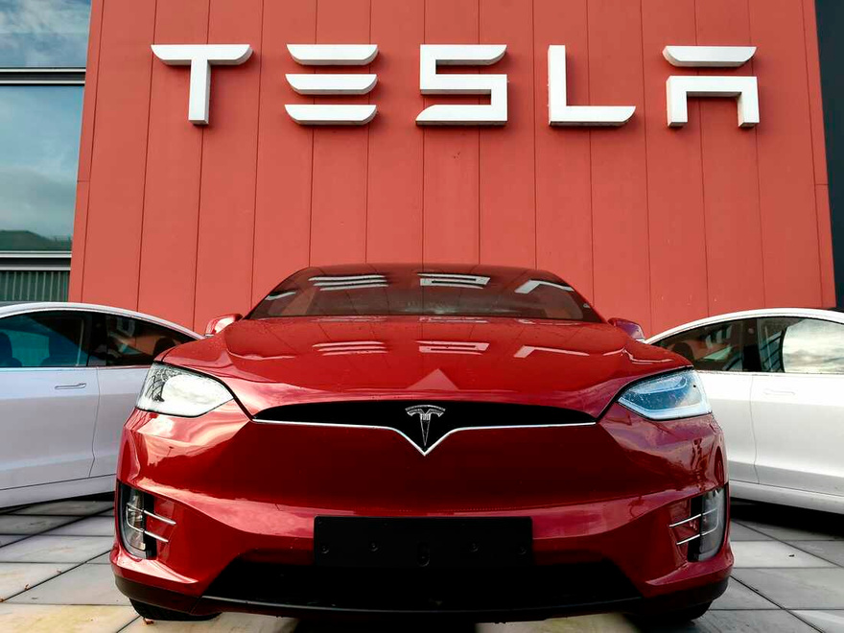

Slide 3


Slide 4


Slide 5

Customers who bought model Y , Suv in Red color of the car in the united states with the year 2023 in the month of march.

Slide 6

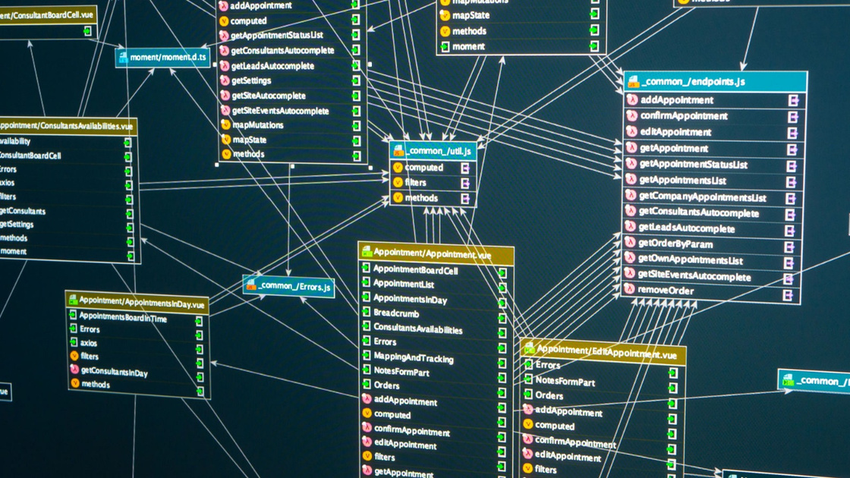
Complex queries in real-time & long time data for retrieval

Slide 7


Slide 8




EFFECTIVE CONVERSION OF BUSINESS QUESTIONS TO DATA QUERRIES BY PRETRAINED DATABASE MODELS USING LANG CHAIN
Nikhitha Guntaka (QG32451)

Slide 9
PROBLEM
01. BUSINESS NEED
SQL queries are essential for data extraction and analysis.
Simple user interface for business experts
SQL is a powerful language for database interaction.
The average user lacks the expertise to write SQL queries.
This creates a barrier to accessing valuable data
02. LACK OF EXPERTISE
Manual query writing is time-consuming and error-prone.
This creates a barrier for non-technical users seeking data insights.
03 - TIME CONSUMING

Slide 10
BEYOND CHATGPT
Feature | ChatGPT | Our Project
Purpose | General-purpose chatbot | Specific domain: Car Inventory Queries
Data Source | Vast internet text data | In-house MySQL car database
Model | GPT-3 | Google PaLM
Focus | Open-ended conversation | Efficient database query translation
Manual SQL queries are time-consuming and require technical expertise.
Non-technical users struggle to access valuable data insights.
Inefficient use of data analysts' time.

Slide 11
Introduction
We use a Large Language Model (LLM) to bridge natural language and SQL.
Users type questions as they would ask a person.
The LLM translates these questions into accurate SQL queries

Slide 12
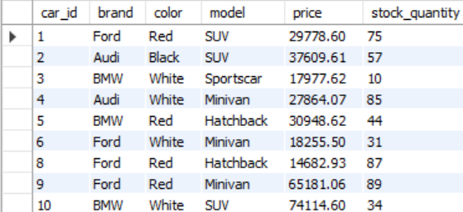
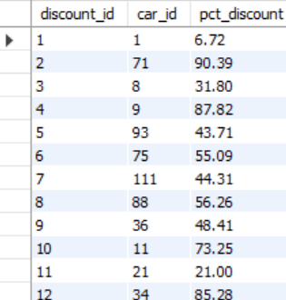
Cars Tabel
Discounts Tabel
Complex Database Structures in Real time

Slide 13
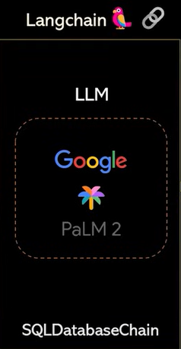

SELECT stock_quantity FROM cars WHERE brand = 'Ford' AND model = 'Sedan' AND color = 'White'
How many cars do we have left for ford in sedan model and white color?
Cars Databse

Slide 14
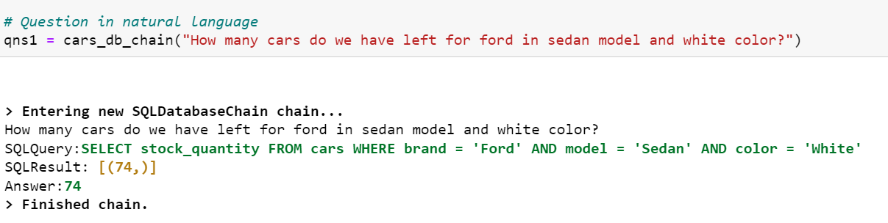
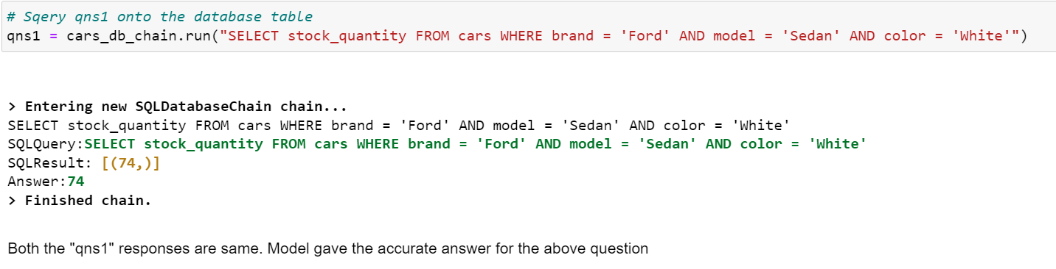
CORRECT
Model Generated Result
Manual Query Result

Slide 15
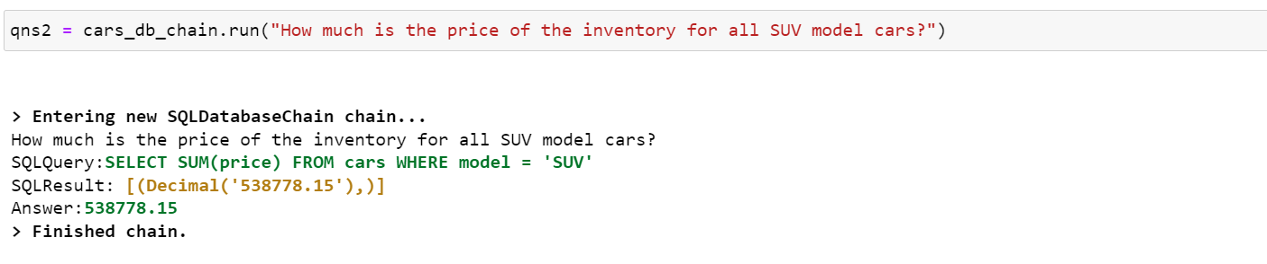
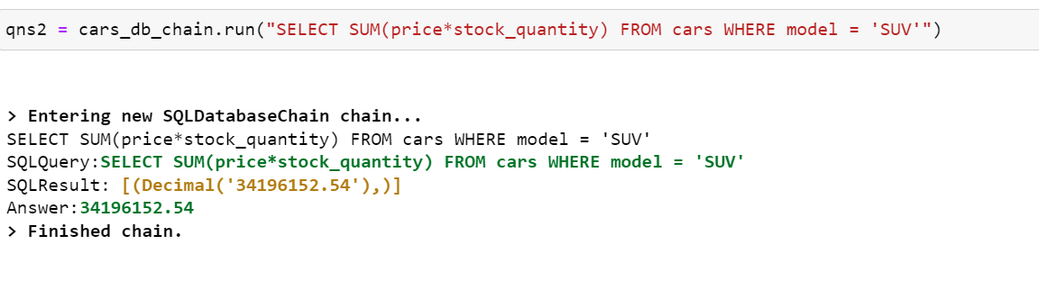
WRONG
Model Generated Result
Manual Query Result

Slide 16
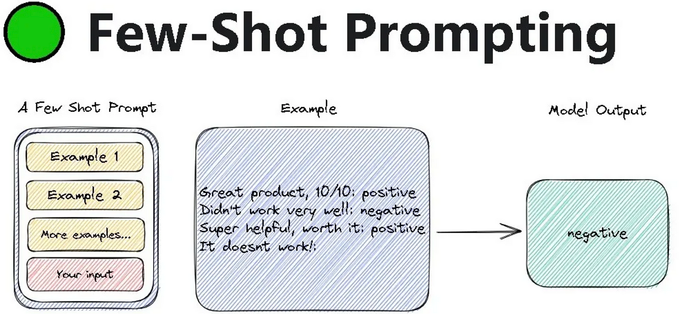
Few-shot learning is like training a foundational model to learn new things quickly, even with just a few examples.
In the project trained Google PLAM to understand car data and translate user questions into SQL queries, all with a relatively small dataset of questions and their corresponding SQL answers.
This makes it faster and cheaper to train the model and allows you to easily adapt it to handle new types of questions about the car inventory data.

Slide 17

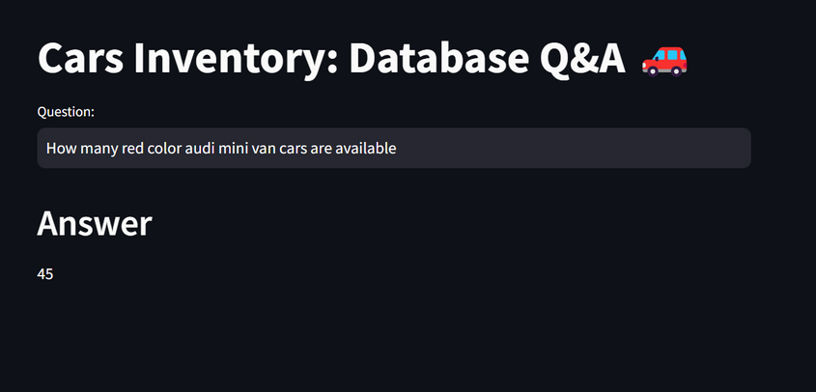
Few shots
Hugging Face Embeddings
ChromaDB
'sentence-transformers/all-MiniLM-L6-v2'
'Question': "How many cars do we have left for ford in sedan model and white color?",
'SQLQuery': "SELECT stock_quantity FROM cars WHERE brand = 'Ford' AND model = 'Sedan' AND color = 'White'",
'SQLResult': "Result of the SQL query"
array([[ 0.10627505, 0.0035465 , 0.07060822, ..., -0.0435442 ,
0.00123346, 0.0111582 ],
[ 0.02717914, 0.02020531, 0.03316246, ..., -0.06554341,
-0.04448341, 0.02425225],
[-0.0707102 , 0.08309388, -0.04087395, ..., -0.08223813,
User Interface
Google Palm

Slide 18
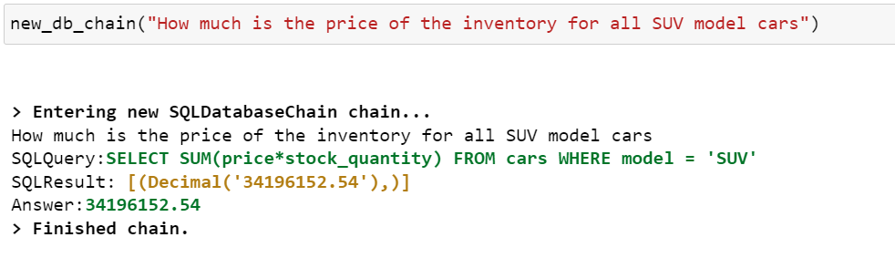
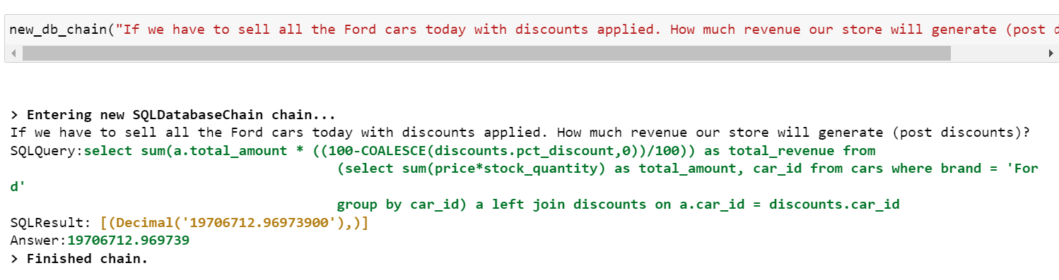
Model Generated Result
Model Generated Result

Slide 19
TECHNICAL APPROACH
Few-Shot Learning
SQL Query Generation
API Gateway
02
04
06
01
03
05
07
User Interface
Text Embedding
Store in Vector DB
Response to User

Slide 20
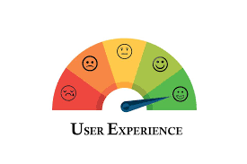
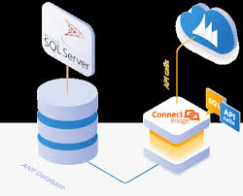


BENEFITS
Improved User
Experience
Faster Data Retrieval
Reduced Training Costs
Flexibility

Slide 21
Quick Demo

Slide 22
REFRENCES
Few shot learning. (2022, June 22). Hugging Face Forums. https://discuss.huggingface.co/t/few-shot-learning/19444
Martineau, K. (2024, May 1). What is retrieval-augmented generation? IBM Research. https://research.ibm.com/blog/retrieval-augmented-generation-RAG
MySQL :: MySQL 8.0 Reference Manual :: 5.3.1 Creating and selecting a database. (n.d.). https://dev.mysql.com/doc/refman/8.0/en/creating-database.html

Slide 23
THANK YOU

